Slide 1
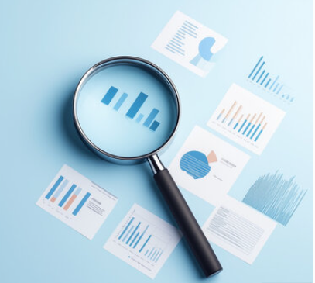

Predicting Disease Outbreak using Social Media & Hospital Data
_
Presented By:
Rayyan ahsan – F2022332051
muqaddas Iftikhar – F2022332052
Ghayoor Fatima - S2023332029

Slide 2
Outline:
Overview and Problem Statement
Data Pipeline & Methodology
Machine Learning Implementation
Results & Performance Analysis
Conclusion

Slide 3
Overview
Analyze Twitter data related to COVID-19 using Big Data technologies
Classify tweets as "Normal Tweet" vs. "Outbreak Tweet" using machine learning
Discover key discussion topics using topic modeling

Slide 4
Motivation
• Disease outbreaks spread rapidly and affect millions
• Hospital data is reliable but often delayed
• Social media provides real-time health signals
• Combining both enables earlier detection

Slide 5
Problem Statement
Social media generates massive volumes of unstructured data during global events
Manual analysis of millions of tweets is impractical
Need automated systems to extract meaningful insights about public sentiment during pandemics
Tools and Technologies:
PySpark (Primary processing engine)
Google Colab (Cloud execution environment)
Python Libraries: NLTK, Scikit-learn, Matplotlib
Big Data Approach: Distributed computing for large-scale text processing

Slide 6
Data Pipeline
1. Data Collection(Kaggle)
2. Preprocessing & NLP
3. Feature Engineering (TF-IDF)
4. Machine Learning Model
5. Prediction & Evaluation

Slide 7
Methodology
• Removed nulls & duplicates
• Text cleaning & tokenization
• Stopword removal & lemmatization
• Train-Test split (80/20)

Slide 8
Machine Learning Implementation
Label Creation Strategy:
Outbreak Tweets (Label 1): Contains keywords: "death", "hospital", "icu", "infection"
• Model: Logistic Regression
• Labels:
- Outbreak Tweet = 1
- Normal Tweet = 0
• Topic Modeling using LDA

Slide 9
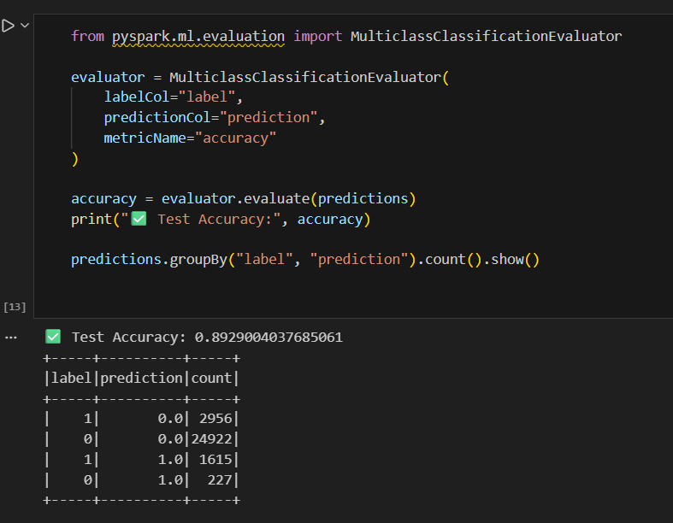
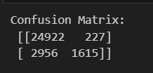
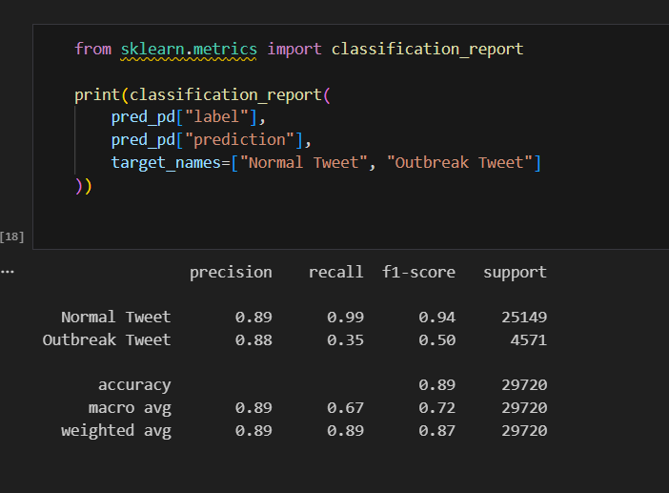
Results & Performance Analysis

Slide 10
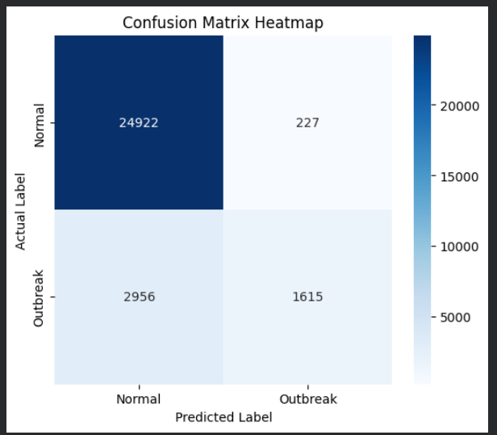
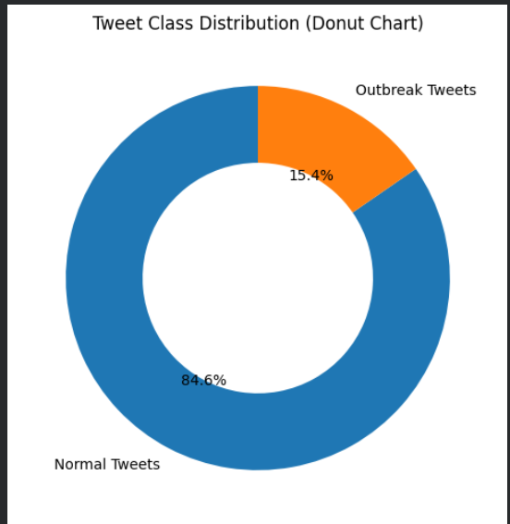
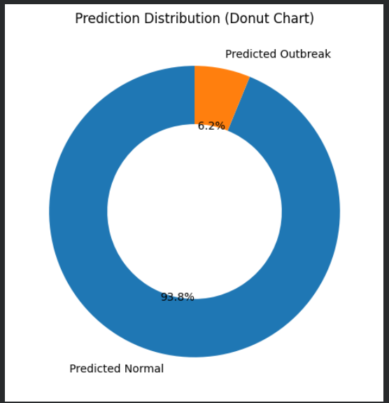
Graphs

Slide 11
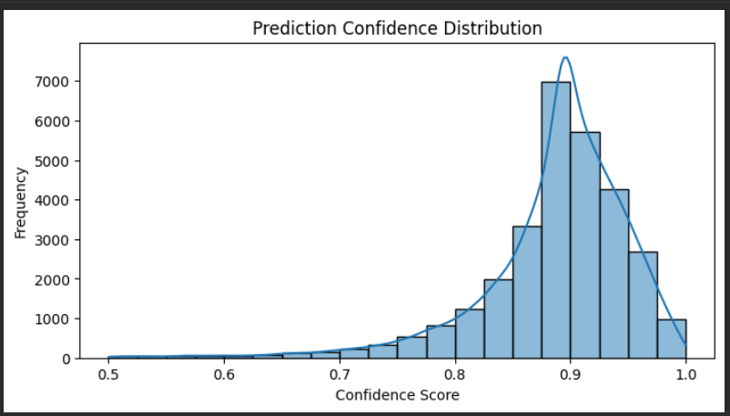
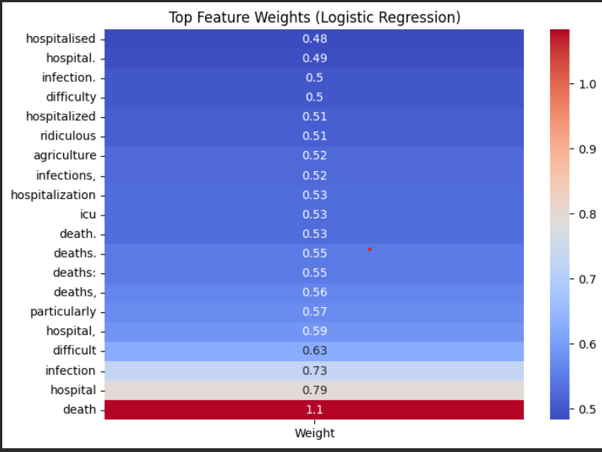

Slide 12
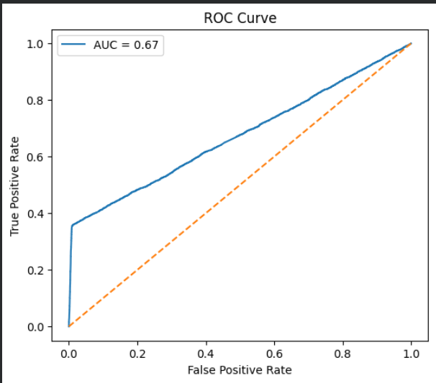

Slide 13
Conclusion
Successfully processed large-scale Twitter data using PySpark
Built a classifier with 89.3% accuracy for outbreak-related tweets
Extracted meaningful topics from unstructured social media data
Demonstrated the power of distributed computing for NLP tasks

Slide 14


